Slide 1
AS Level Global Perspectives
Created by: Lindsey Sanchez

Slide 2
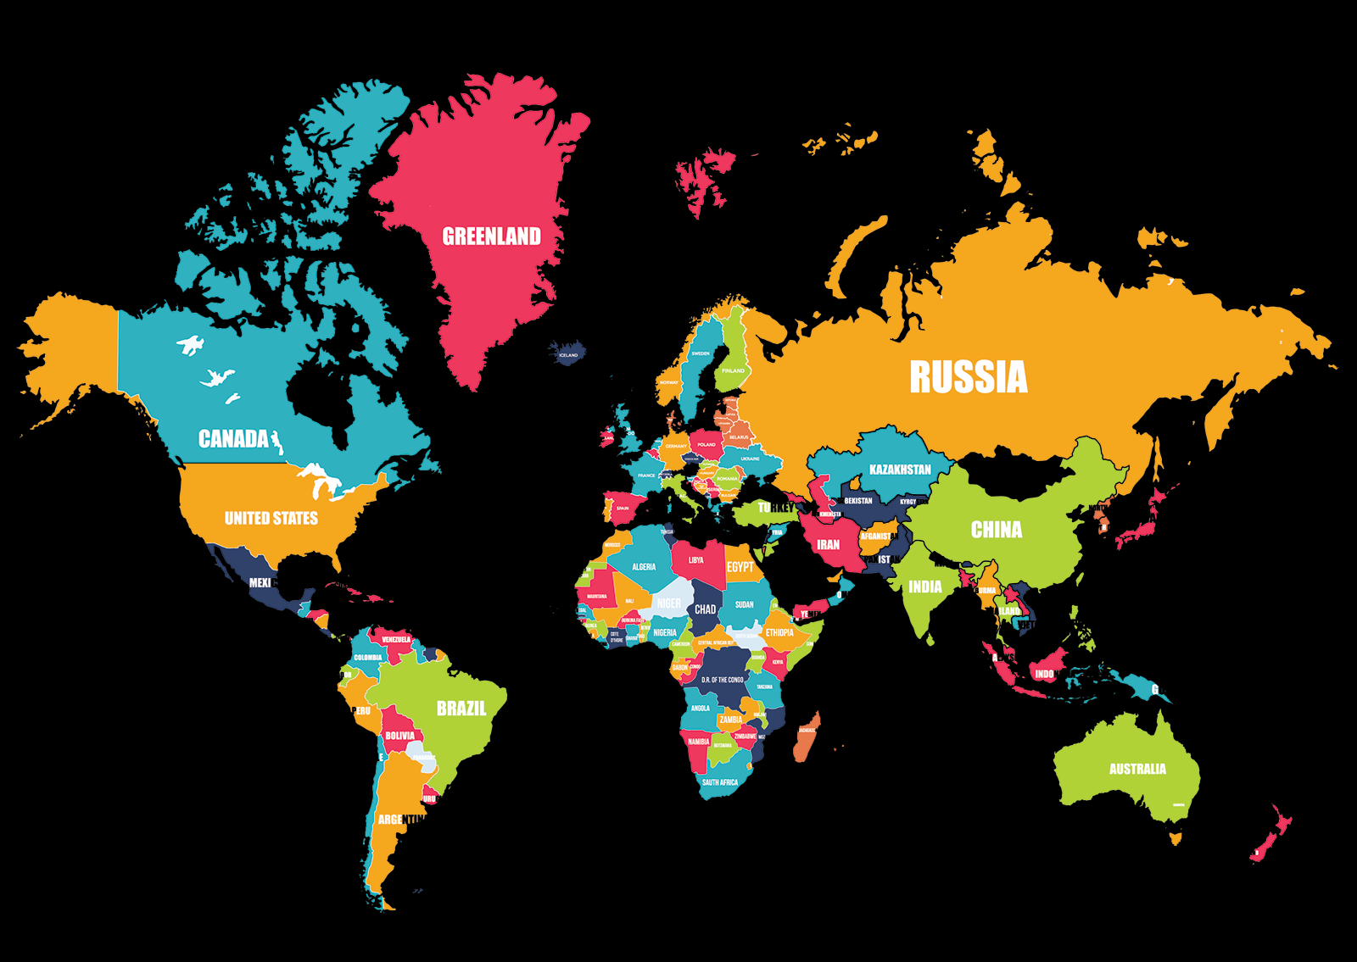
Its Time to figure out a question!
Don’t Panic!!
Getting Back To the Basics
  Is Your Question Global?
    This is one of the most important aspects of your question!!
      If your question is not global, you will NOT pass!!
        For your question to be global, it needs to allow you to be able to have evidence and examples from ALL around the world, not just the United States and Europe!!
              DO NOT make it US specific!
Ex. Is the FDA effective?

Slide 3
CAN YOUR QUESTION BE ANSWERED BY YES OR NO???
If you can answer your question with yes or no, throw it out, its trash!!!
Your question should be open ended
  DO NOT!!
    Make the question an ‘either/or/as’
      Ex. Are GMOs harmful or helpful?
      Ex. Are bottled sodas just as harmful as water bottles?
  DO NOT!!!
    Make it ‘to what extent…’
      Ex. To what extent are factory farms bad?

Slide 4
What not to do!!
DO NOT!!!
  Make it too wordy
    Ex. Is increasing regulation of industrial pollution necessary to prevent aquatic biome from further deterioration
    DO NOT!!!
      Use terms that are up to interpretation.
        Ex. “good”, “dangerous”, “effective”
DO NOT!!!
  Say something along the lines of “…positives outweigh the negatives…”
    Ex. Do the benefits of using clean energy outweigh the negatives?

Slide 5
WHAT YOU NEED TO DO!!!!
DO: Make clever questions.
  Ex. Is fashion killing you? •
Use sophisticated vocabulary.
  Ex. Are anti-western feelings woven into the culture of the middle east?
"The difference between a successful person and others is not a lack of strength, not a lack of knowledge, but rather in a lack of will." Vincent T. Lombardi

Slide 6
WHAT YOU NEED TO do!!!!
Make it global.
  Ex. Is the movement of refugees shaping the global economy?
Make it original.
  Ex. Is female genital mutilation a global concern?
Make it something you are interested in.
  Ex. Genocide is the answer to the world over-population. Why is beauty determined by the media?

Slide 7


You will do great!!
If you follow all these guidelines, you will be fine!!!
GOOD LUCK!!!
    “Believe in yourself. You are braver than you think, more talented than you know, and capable of more than you imagine.” ― Roy T. Bennett, The Light in the Heart
IS IT GLOBAL?
IS IT OPEN ENDED?
IS IT ORIGINAL?

